Slide 1
Found Working vector for 2020 Year with a drones

Slide 2
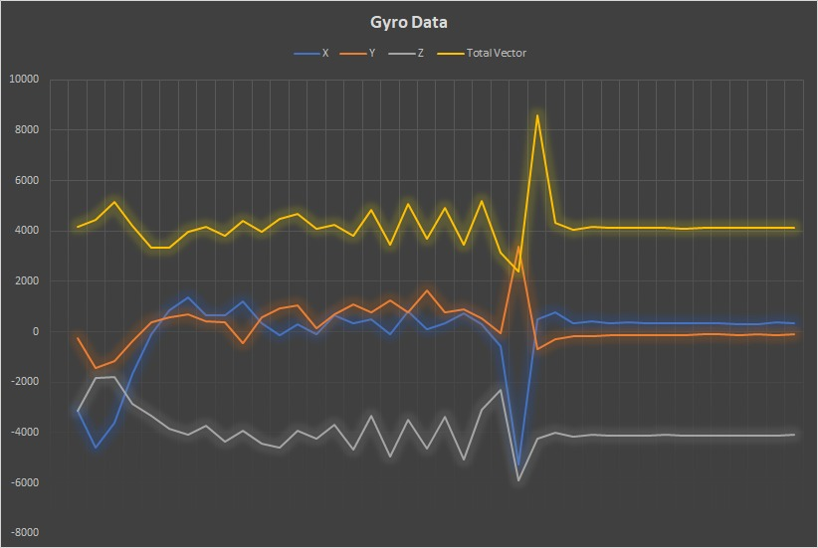
Also Working With Gyro Data Maybe we had a problem with vibration isolation.

Slide 3
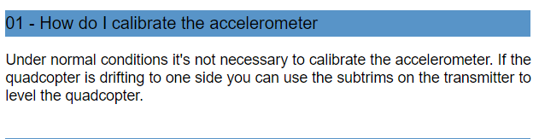
Also We can try too work with subtrims

Slide 4
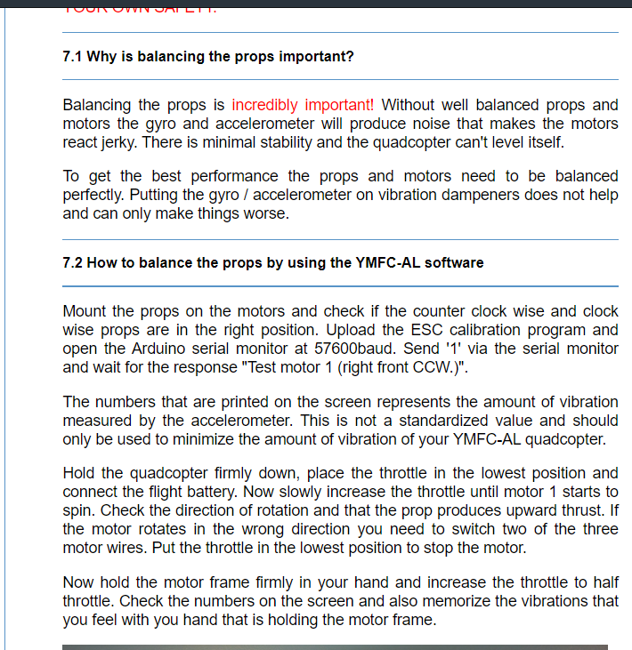
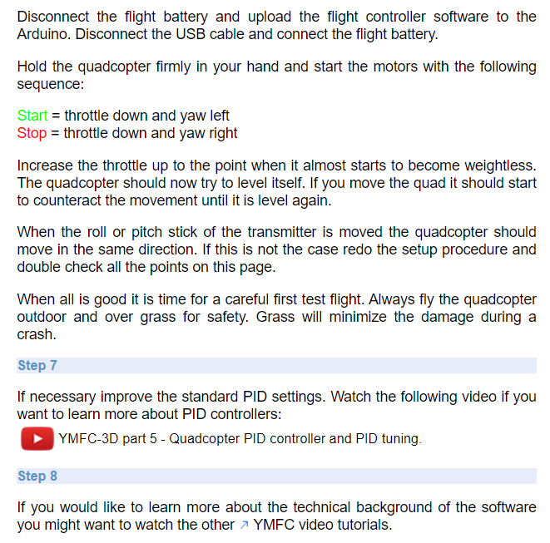
Also We can do this one and make SOLUTION

Slide 5
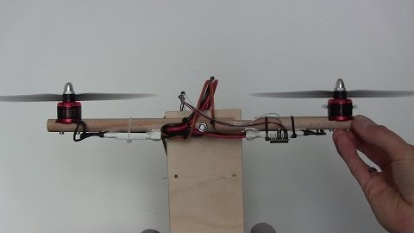

Slide 6
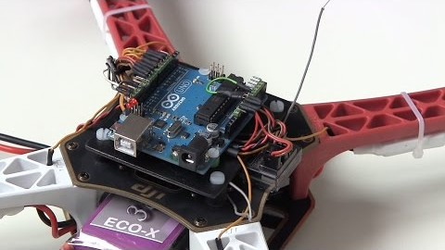

Slide 7



